Slide 1
Welcome to SDZ’s Python Workshop #2
By Riko Hamblin and Ibukun Oluwayomi

Slide 2
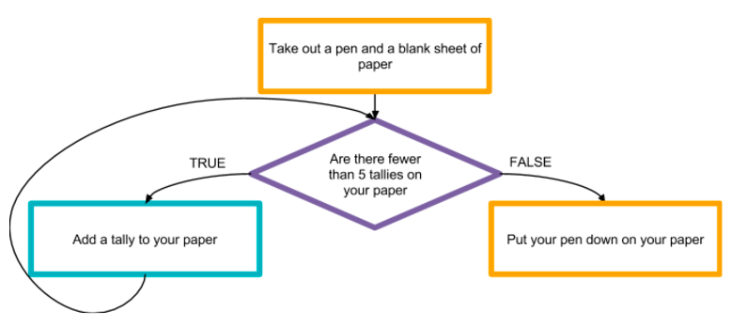
Sometimes we want our program to repeat a task multiple times.
Notes:
Mention that the 3 things to notice are: 1)What is it you want to repeat 2)What stops your loop 3) what happens after your loop

Slide 3
Loops!
Used when we want to:
Repeat code multiple times as long as a condition is true e.g. Add up a user’s input as long as it’s more than or equal to 5 [ >= ]
Or a predetermined amount of time e.g. Ask a user for 267 integers.

Slide 4
Loop Logic
It repeats a set of commands.
It continues to run while a boolean expression is true.
It is called a loop because it loops through a set of commands.
Things to pay attention to when programming loops:
Something inside the loop has to update the variable in the condition so the loop will eventually stop
Loops may never run if the condition begins as false
Loops can run forever if the condition never becomes false

Slide 5
How to make a loop in Python
Python has 2 types of loops.
While loops: Used when you don’t know when exactly a loop should end
For loops: Used when you know exactly how many times you need the loop

Slide 6
While loops
While this is true : do this Update the condition.
Why is it necessary to update the condition?

Slide 7
Countdown Program
number = int(raw_input("Enter the number to countdown from: "))
while number>=0:
print number
number = number-1
print "Lift off!!!!!"
This is the condition
This is the update
This only gets printed when the loop is done.

Slide 8
For Loop
sum = 0
for i in range(5):
sum = sum + i
print sum
for num in range(10,25): print num,

Slide 9
The range() method
The range method can take one, two or three parameters.
range(stop) range(start, stop) range(start, stop, step)
range(10): This means 0 , 1, 2, 3, 4, 5, 6, 7, 8, 9
range(4, 10): This means 4, 5, 6, 7, 8, 9
range(1,10, 2) This means 1, 3, 5, 7, 9

Slide 10
App of the day! ( #1 )
We will write a program that randomly generates a number. The user guesses the number and the program will say if it’s too high or too low. The game continues until the guess is correct.

Slide 11
Thought Process
Generate a random integer between 1 and some limit
Ask the user for their guess
As long as their guess is not the random integer: 1) Determine if the guess is higher or lower than the random integer and print corresponding message
2) Ask for another number from the user
….What happens after the loop is finished??

Slide 12
How to generate a random integer
This is python module that comes with the language. It has many useful methods. Such as one for generating random numbers.
import random
randomNumber = random.randint(1,5)
The method returns a random number between 1 and 5 (inclusive)

Slide 13
How to change a String to an integer
# we need to use the int() method to convert our string to an integer.
# we could use the float function too.
guess = int(raw_input("Make a guess: "))

Slide 14
Final hint
# The while loop will continue to repeat as long as this condition is true.
while guess != randomNumber: #tell them if it’s higher or lower
Does the condition make sense?
!= means “NOT EQUAL TO”

Slide 15
Thought Process
Generate a random integer from 1 to some limit
Ask the user for their guess
As long as their guess is not the random integer: 1) Determine if the guess is higher or lower than the random integer and print corresponding message
2) Ask for another number from the user
….What happens after the loop is finished??

Slide 16
What happens after the loop is finished?
Print a congratulatory message!

Slide 17
What happens after the loop is finished?
print "’\nYou guessed right!!"
print "The Mystery Number was: ",number

Slide 18
App of the day! ( #2 )
Shape Area Calculator Write a program that will ask the user for an input: If the input is 1 then calculate the area of a square (hint: you will need to ask the user for length) If the input is 2 then calculate the area of a circle (hint: you will need to ask the user for radius) If the input is 3 then end the program. Keep repeating the process as long as the input is not 3.

Slide 19
How this can be applied in the real world
Consider reading lines of information from an unknown text file. We usually have no idea how many lines of information are in the file. So, we will like to keep reading until there is nothing else to read. The following is pseudocode. while theFile still has lines: content = theFile.readALineFromFile() #process content here

Slide 20
What did we learn today?
How to convert strings to integers and floats.
How to generate random numbers.
How to repeat a task using while and for loops (remember to update a condition within a loop so that it terminates eventually).

Slide 21
Congratulations
We finished our second workshop!

